Slide 1

Unit 1:- Electric and Hybrid Powertrain Technologies
By:- Prof. Dr. Saket Yeolekar

Slide 2
Lecture 7
Operating Mode : Series-parallel Hybrid
E-CVTs Electric Continuous Variable Transmission)
M-CVTs (Magnetic Continuous Variable Transmission)
Compound Hybrid Configuration
Compound Hybrid Modes of Operations
Plug-in Hybrid Electric Vehicles (PHEVs)
PHEVs Operations
Comparisons
Hybrid Hydraulic Vehicles (HHVs)
HHVs Operations
Series Hydraulic Hybrid Powertrain
Series HHV Operations

Slide 3
Operating Mode : Series-parallel Hybrid ….
There are two groups in operating mode of a series parallel hybrid powertrain: ICE-heavy, Electric-heavy.
The operation mode of ICE-heavy is similar to that of a parallel hybrid powertrain, in which the engine is more active than the electric motor.
The operation mode of Electric-heavy is similar to that of a series hybrid powertrain, in which the electric traction motor is more active than the engine
A series-parallel hybrid powertrain uses a power split device to effectively combine the engine driving power and the motor driving power. A planetary-geared, electrically controlled, continuous variable transmission (E-CVT), and magnetic continuous variable transmission (M-CVT) are the main devices used to combine the powers.

Slide 4
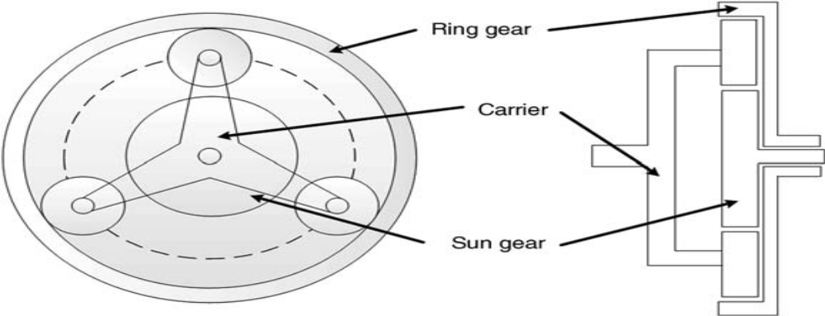
E-CVT….
E-CVTs typically function as a power split device in hybrid powertrains to combine the engine power and the electric motor/generator through a planetary gear set.
A planetary gear set makes it possible to achieve a combination of either two input shafts and one output shaft, or a combination of one input shaft and two output shafts.

Slide 5
E-CVT….
The ring carrier transfers the traction motor power to the final drive only during “electric mode,” while it can provide additional traction power to the wheels during “hybrid mode.”
The sun carrier is used during regenerative mode or for starting the engine.
In addition to the ability to continuously vary the speed of the engine, the E-CVT has a smooth and continuous performance during the regenerative braking process.
However, it suffers from low power density, low efficiency, and noise problems. High speed or high load conditions can magnify these issues

Slide 6
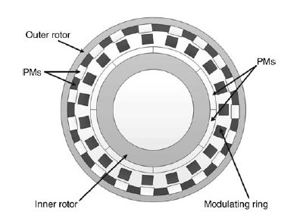
M-CVT….
A magnetic continuous variable transmission (M-CVT) achieves torque transmission and variable gear ratios by magnetic materials and without mechanical contact.
It includes: three coaxial magnetic rotors, namely, the outer rotor, the inner rotor, and the modulating rotor, as well as a stator and electronic control unit
This device splits the power flow from the engine into two paths.
First Path generates power by sharing the outer rotor (magnetic gear) with the rotor of the traction motor
Second forms by sharing the inner rotor of the magnetic gear with the rotor of the motor-generator

Slide 7
M-CVT….
Two consecutive converters, which are separately coupled to the stators of the motor and the generator, control the generated power flow.
The proper locking of the rotors, which activate and deactivate the magnetic field according to the engine load and driving conditions, provide a continuous gear ratio change and a proper power split.
The outer rotor transfers the traction motor power to the final drive only during “electric mode,” while it can provide additional traction power to the wheels during “hybrid mode.” The inner rotor works during regenerative mode, or for starting the engine.

Slide 8
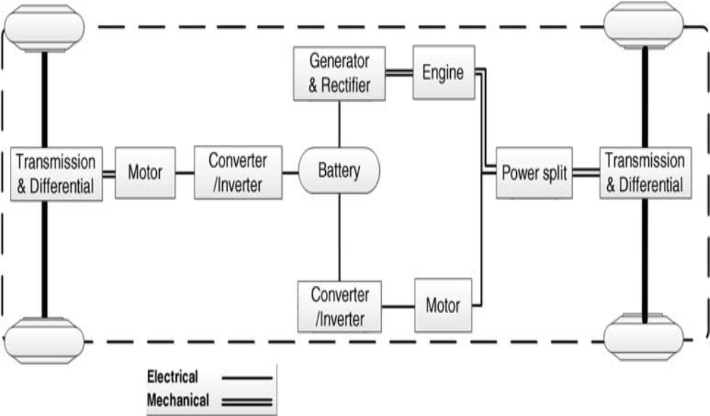
Compound Hybrid Configuration….

Slide 9
Compound Hybrid Modes of Operations….
The structure of a compound hybrid configuration, also known as a complex hybrid, is similar to that of a series-parallel hybrid
The difference relies on the bidirectional functionality of the electric motor in a compound powertrain and the unidirectional functionality of the generator in a series-hybrid powertrain
Modes:
Start-up mode: In this mode, the engine is off, while the battery provides electrical power to both the front and rear electric motors to individually drive the front and rear axles.
Electric mode: In this mode, the battery provides the power to only the front electric motor to propel the front axle, while the engine and rear electric motor are off. This operation mode occurs during light load driving conditions.

Slide 10
Compound Hybrid Modes of Operations ….
Hybrid mode: In this mode, the engine and two electric motors are on. The engine and front electric motor work together to propel the front axle, while the rear electric motor simultaneously drives the rear axle. This mode is on during heavy load conditions, such as full-throttle acceleration.
Engine traction and battery charging mode: In this mode of operation, the engine power is divided to provide the traction power to the front-wheel axle and to charge the battery through the electric motor, which is switched to its generator mode. This mode is suitable for normal driving conditions.
Regeneration mode: The regenerative braking system charges the batteries during braking, decelerating, and downhill travel. In this mode, the two electric motors operate as generators to simultaneously recharge the battery.

Slide 11
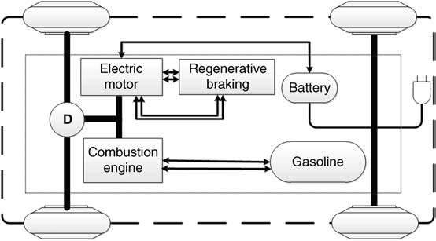
Plug-in Hybrid Electric Vehicles (PHEVs)….

Slide 12
PHEVs Operations ….
Plug-in hybrid electric vehicles combine the advantages of hybridization with the chance to travel using only electricity provided by the grid for a certain time, rather than just through internal recharging systems.
The primary power source of PHEVs is electricity, while the ICE may be used as the secondary power source.
Advantages of PHEVs over BEVs include its reduced dependence on recharging infrastructure which lowered costs
PHEVs can be emission-free if they run on electricity mode
a PHEV labeled PHEV‘X’ indicates the distance the vehicle can travel when in electricity mode. For example, “PHEV20” stands for a plug-in hybrid vehicle capable of running on electricity for 20 km

Slide 13
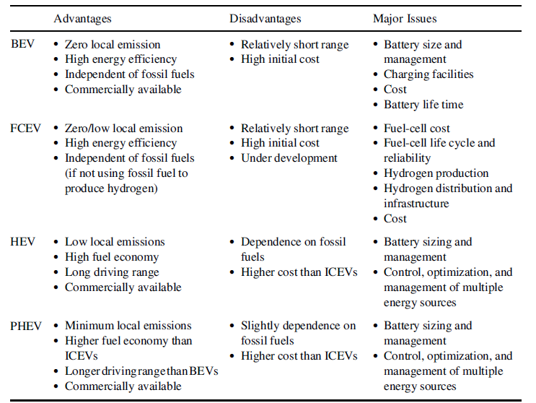
Comparisons….

Slide 14
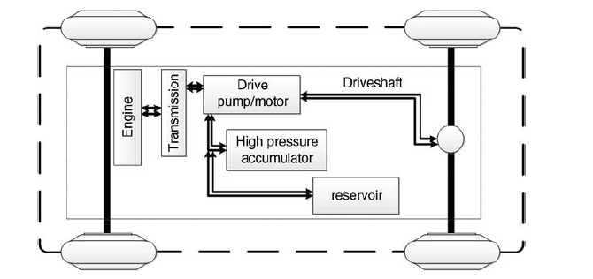
Hybrid Hydraulic Vehicles (HHVs)….
A Parallel Hydraulic Hybrid Powertrain Structure

Slide 15
HHVs Operations….
With a principal operation similar to that of electric hybrids, hybrid hydraulic vehicles (HHVs) use two propulsion power sources: an IC engine and a hydraulic motor.
Hydraulic hybrid systems transfer energy from the engine to the wheels using fluid power.
An accumulator, a reservoir, and a hydraulic drive (pump/motor) are the main components that establish the drivetrain of HHVs
The accumulator is a high pressure hydraulic fluid vessel that stores energy and compresses nitrogen gas using hydraulic fluid
The hydraulic drive pressurizes and transfers hydraulic fluid from the reservoir to an accumulator when it operates as a pump or vice versa when it operates as a hydraulic motor.
With current technologies, it is possible to recuperate up to 30% of lost friction energy in HEVs.

Slide 16
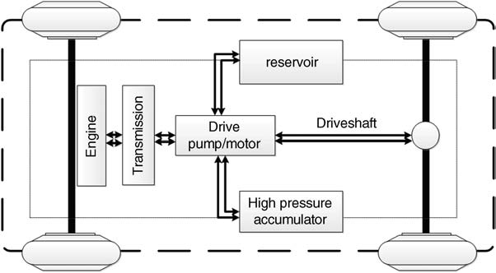
Series Hydraulic Hybrid Powertrain….
A Series Hydraulic Hybrid Powertrain Structure

Slide 17
Series HHV Operations….
Hydraulic power stored in the accumulator is directly transmitted to the wheels while decoupling the ICE from the wheel loads
This configuration does not have the conventional powertrain, and the vehicle is propelled by the transfer of high-pressure fluid from the accumulator to the reservoir through the drive acting as a motor.
The series configuration involves fewer mechanical components than a parallel configuration, thus resulting in better efficiency
In addition, this configuration switches the ICE off when it is not at optimum working operations, such as during light acceleration or short cruising. the engine will turn on when the pressure level drops below a certain threshold, and assist the hydraulic system to complete its circuit.

